Slide 1
Chapter 4 Discovering How You Learn

Slide 2
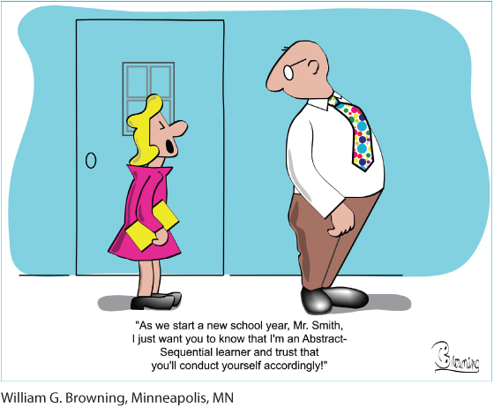
Assess Your Strengths and Set Goals
Understanding your preferred style of learning will help you study and earn good grades. Do you know how you learn best?
Think about your favorite and least favorite classes, and how your preferences might relate to how you prefer to learn.

Slide 3
How People Learn
Neuroscientists and psychologists have developed many theories about how and why people learn differently.
Many theories about learning are relevant for college students.

Slide 4
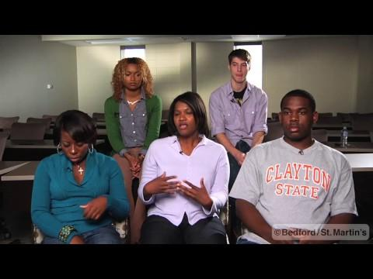
http://drive.google.com/file/d/1nH74HTly0G6e2PpYauQTfwo3nymqergF/view
Notes:
Possible discussion starter questions:
What are your preferred ways to learn? Why do you prefer these ways of learning?
How will knowing your learning style help you become a successful student?
Why is it important to adjust and adapt your learning styles? How can you do this when you are in class?

Slide 5
“Hierarchy of Needs”
Abraham Maslow created the “hierarchy of needs” theory:
For students to learn, needs must be met
Some basic needs are: physiological needs (food & water); safety and security; love and belonging.
Can you identify other needs in Maslow’s Hierarchy of Needs Pyramid?
Notes:
Instructors: Have students identify the other needs in Maslows “hierarchy of needs” and provide examples. The other needs identified in the chapter are self-esteem and self-actualization.

Slide 6

Social Learning Theory
Psychological researcher Albert Bandura created the social learning theory:
People learn by observing others actions and results of those actions
Observations help them repeat of avoid certain behaviors
Can you provide some examples of social learning theory?

Slide 7
Knowles’s Theory of Adult Learning
Adults:
Are self-directed learners
Possess valuable experience
Are ready to learn
Recognize the need to learn
Are more internally motivated

Slide 8

Theory of Transition
Counseling psychologsist Nancy Schlossberg developed the theory of transition:
Adults learn new roles when they experience change in their lives
Change helps growth and learning
What kinds of transitions have you experienced in your life?

Slide 9
Different Learning Styles
Instructors have their own teaching and communicating styles.
Your preferred style of learning may not match your instructor’s teaching methods.
Everyone has different learning styles and preferences.

Slide 10
Tools for Measuring Your Learning Style
Learning styles are particular ways of learning and unique to each individual:
Some theories are simple, some are complex
Learning frameworks will help you meet the expectations of each course and instructor
There are several tools that can be used to measure your learning style

Slide 11

VARK Learning-Styles Inventory
The VARK focuses on how learners prefer to use their senses. There are four types:
Visual learners
Aural learners
Read/Write learners
Kinesthetic learners
You may be multimodal, and prefer multiple learning styles.
What is your VARK inventory score?

Slide 12
Study Strategies by VARK Learning Style
Visual | Aural | Read/Write | Kinesthetic
Underline or highlight your notes. | Talk with others to verify the accuracy of your lecture notes. | Write and rewrite your notes. | Use all your senses in learning: sight, touch, taste, smell, and hearing.
Use symbols, charts, or graphs to display your notes. | Put your notes on audio-tape, or audiotape class lectures. | Read your notes silently. | Supplement your notes with real-world examples.
Use color to highlight important concepts. | Read your notes out loud; ask yourself questions and speak your answers. | Organize diagrams or flowcharts into statements. | Move and gesture while you are reading or speaking your notes.
Create a graphic repre­sentation of your notes (e.g., a mind map) and redraw it from memory. |  | Write imaginary exam questions and respond in writing.

Slide 13
The Myers-Briggs Type Indicator
The Myers-Briggs Type Indicator (MBTI) investigates personality characteristics and how they relate to human interaction and learning styles.
Identifies and measures a “psychological type” as developed by Carl Jung
Often used by employers

Slide 14
MBTI Types
Extraversion (E) versus Introversion (I): the inner or outer world
Sensing (S) versus Intuition (N): facts or ideas
Thinking (T) versus Feeling (F): logic or values
Judging (J) versus Perceiving (P): organization or adaptability
What is your MBTI personality type?
Notes:
Instructors: Have your students guess what their MBTI results might be. Then have them take the MBTI questionnaire and compare their actual results to their guesses. If they feel comfortable doing so, have them share their thoughts on their results with the class. The MBTI questionnaire can be found at myersbriggs.org/my-mbti-personality-type/take-the-mbti-instrument.

Slide 15
Multiple Intelligences
Multiple intelligences: theory developed in 1983 by Dr. Howard Gardner that proposes eight different intelligences to describe how humans learn.
Based on the idea that traditional definition of human intelligence is limited
Argues that students should be encouraged to develop the abilities they have, and that evaluation should measure all forms of intelligence
Is there really more than one type of intelligence? What do you think?
Notes:
Instructors: Have your students do a Google search for the phrase multiple intelligences debate. Use the questions in the slide to generate a class discussion about the multiple intelligences debate. Do your students agree with Gardner’s theory or oppose it?

Slide 16
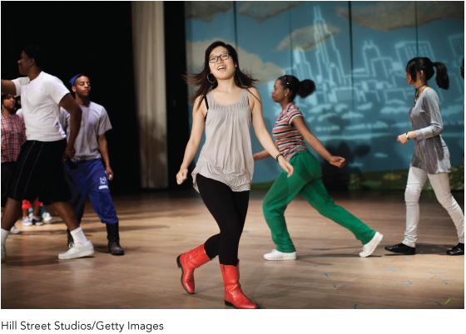
Gardner’s Types of Intelligence
Verbal/linguistic
Logical/mathematical
Visual/spatial
Bodily/kinesthetic
Musical/rhythmic
Interpersonal
Intrapersonal
Naturalistic
In your opinion, which of these eight intelligences best describes you?
Notes:
Instructors: Provide students with information about the eight intelligences.
Verbal/linguistic: likes to read, write, and tell stories and is good at memorizing information
Logical/mathematical: likes to work with numbers; good at problem solving
Visual/spatial: likes to draw and play with machines; good at puzzles, maps, and charts
Bodily/kinesthetic: likes to move around; good at sports, dancing, and acting
Musical/rhythmic: likes to sing and play an instrument; good at remembering melodies and noticing pitches and rhythms
Interpersonal: likes to have many friends; good at understanding people, leading others, and mediating conflicts
Intrapersonal: likes to work alone, understands themselves, and are original thinkers
Naturalistic: likes to be outside; good at preservation, conservation, and organizing a living area

Slide 17
When Learning Styles and Teaching Styles Conflict
Instructors tend to teach in ways that conform to their own styles of learning.
When you recognize a mismatch between how you best learn and how you are being taught:
Take control of your learning process
Don’t depend on your instructor or the classroom environment to give you everything you need
Employ your own preferences, talents, and abilities to study and retain information

Slide 18
Tech Tip: Correlate Online Learning with Your Learning Style
A learning management system (LMS) offers lots of ways to connect with your instructors, classmates, and material:
Auditory learners can create or use audio recordings.
Visual learners can create or use videos, pictures, maps, and graphs.
Hands-on learners can create or use labs, group projects, and fieldwork.

Slide 19
Learning Disabilities
Learning disability is a general term that covers a wide variety of specific learning problems resulting from neurological disorders.
Usually recognized and diagnosed in grade school, though some students can enter college without having been properly diagnosed or assisted.
It can impede the ability to read, write, or do math.
Learning disability is a learning difference, it is not related to intelligence

Slide 20
Attention Disorders
Attention disorders affect the ability to focus and concentrate:
Common in children, adolescents, and adults
Include attention deficit disorder (ADD) and attention deficit hyperactivity disorder (ADHD)
Diagnosis requires evaluation

Slide 21
Cognitive Disorders
Cognitive learning disabilities are related to mental tasks and processing:
Dyslexia
Developmental writing disorder
Developmental arithmetic disorder

Slide 22
Learning with a Learning Disability
Office of student disability services can provide reasonable accommodations to students with learning disabilities:

Slide 23
Reflection
Learn about and accept your unique learning preferences.
Adapt your learning style to the teaching styles of your instructors.
Considering your own learning styles, what might be the best careers for you?

